Slide 1

Sustainable Development Goals and Circular Economy
Jenni Kauppila
Advocacy Officer
United Nations Association of Finland

Slide 2
UNA Finland
Nonprofit NGO founded in 1954​
Umbrella organization for 68 member organizations with 1,3 million individual members​
Local associations in Helsinki, Turku, Tampere, Oulu, Jyväskylä and Lappeenranta​
Friends of the UN network in Finland and at the parliament of Finland, 350 members​
Network of 150 UN Schools, 65 000 students​
Part of WFUNA (World Federation of UN Association) network of 97 national UNA’s, ECOSOC and DPI affiliate​
Notes:
UNA works on information, advocacy & training

Slide 3
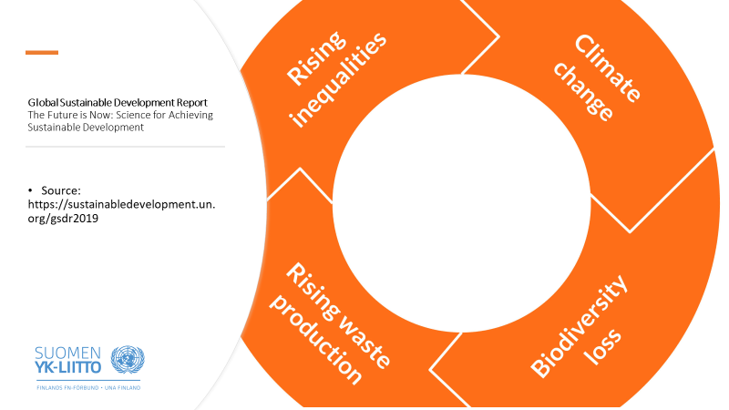

Slide 4
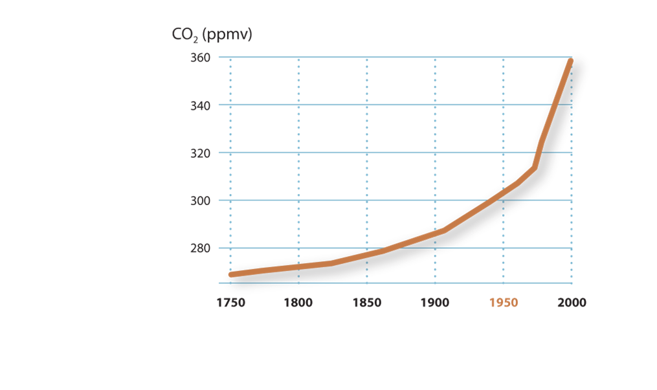
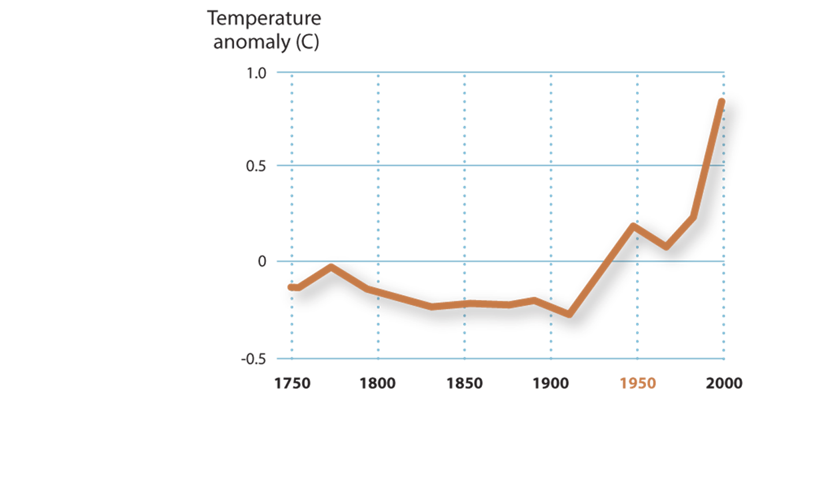
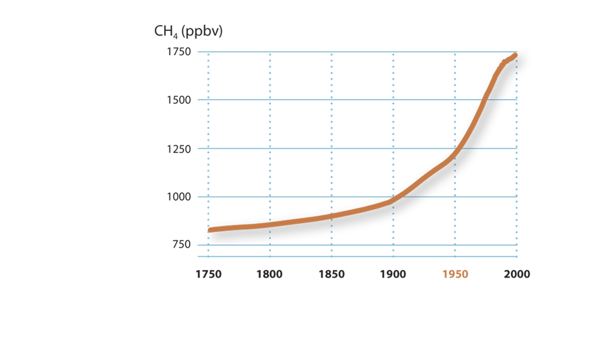
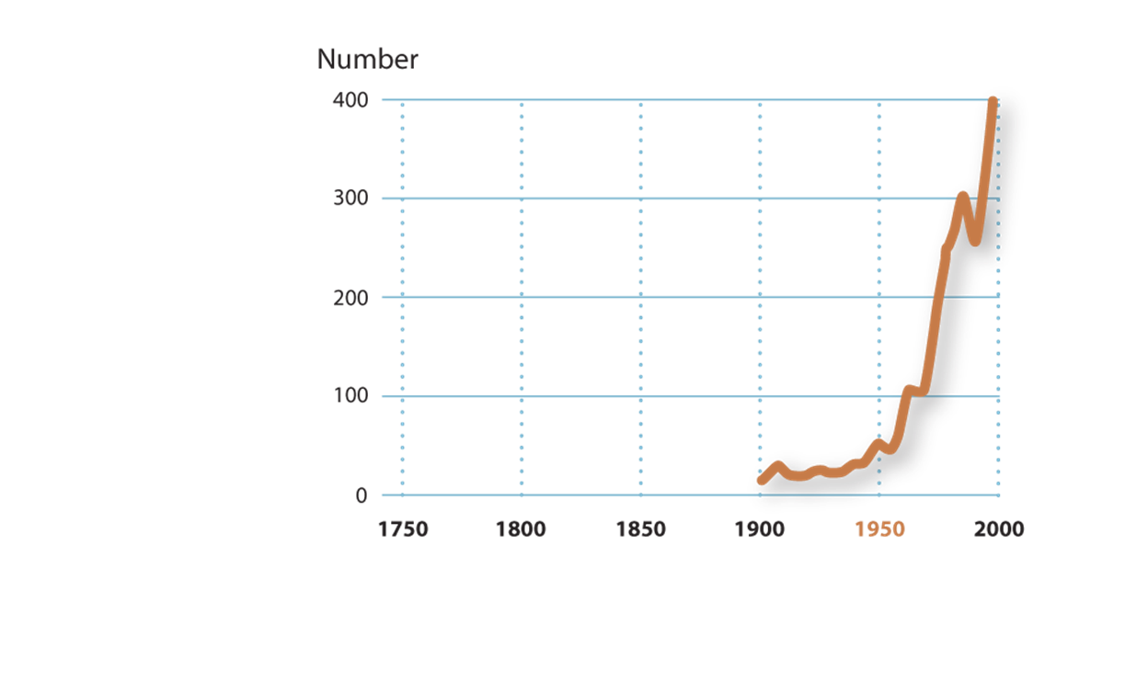
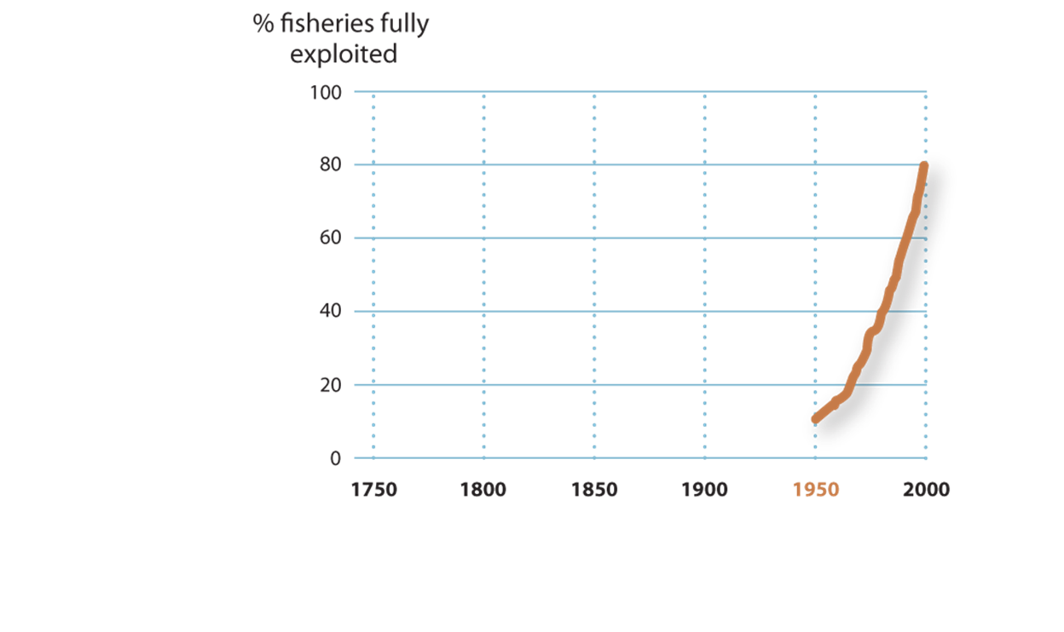
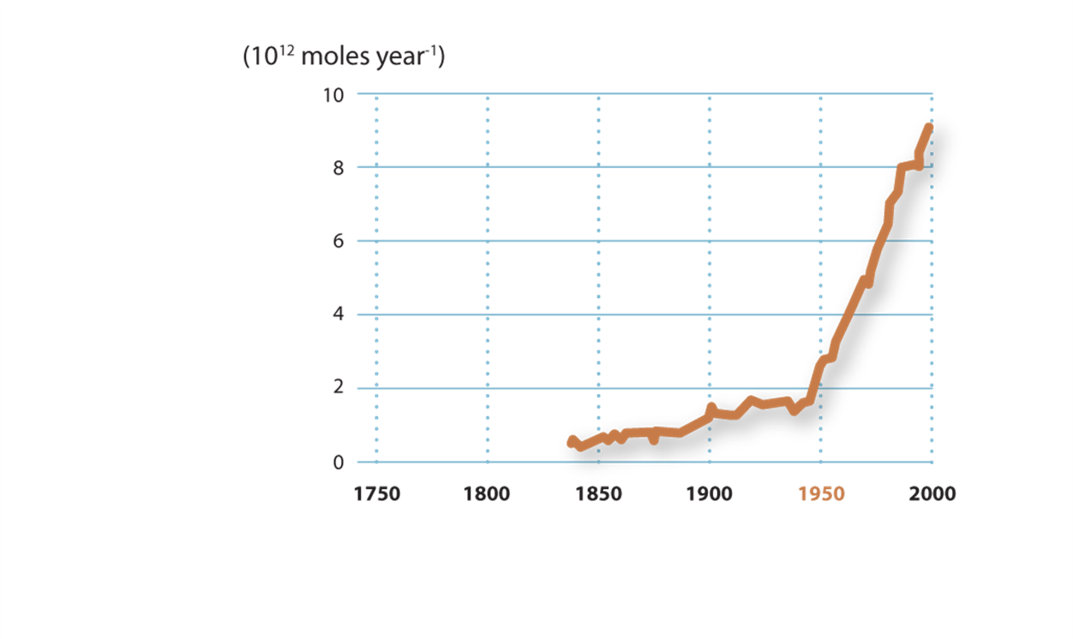
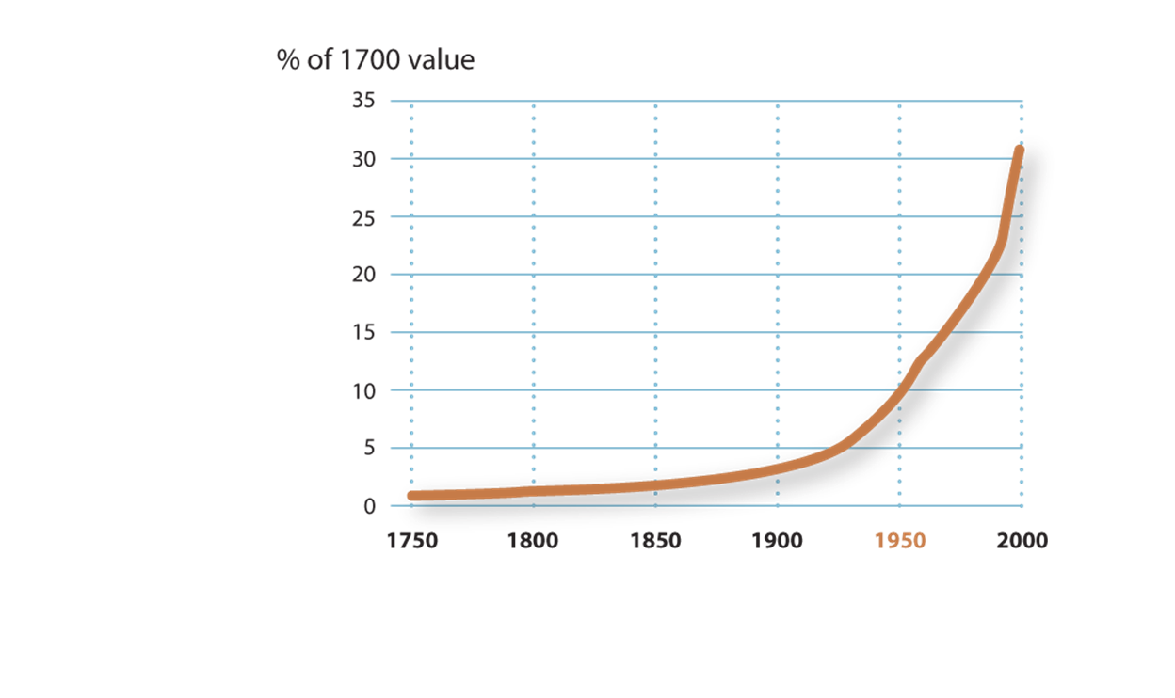
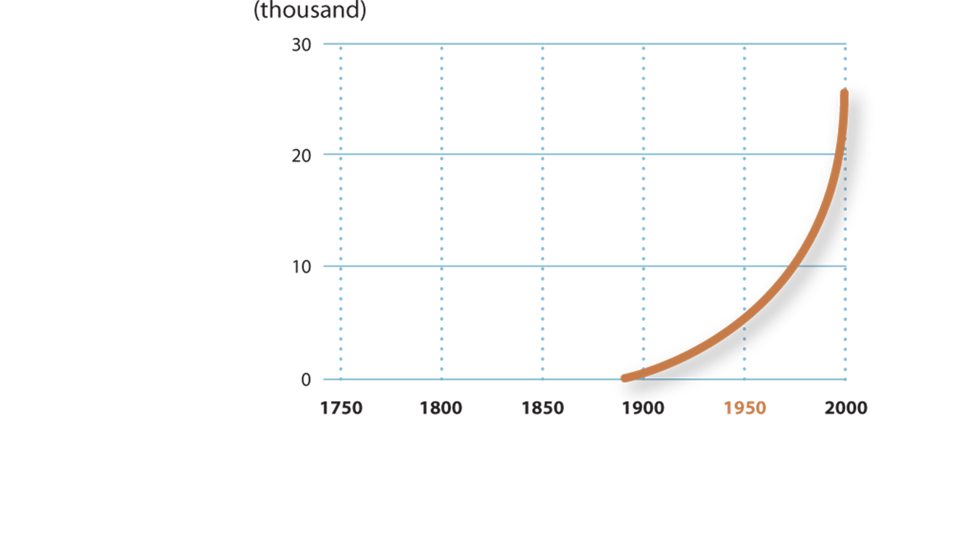
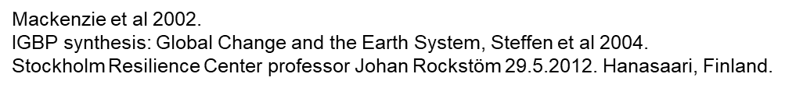
Atmospheric CO2 concentration
Northern hemisphere average surface temperature
Atmospheric CH4 (methane) concentration
Natural climactic disasters
Ocean ecosystems
Coastal zone nitrogen flux
Tropical rainforest and ​woodland loss
Domesticated land
Species extinctions
Notes:
By 2012 Rio+20 UN summit on sustainable development it had become obvious that environmental protection and climate change had to be included more robustly in the new long-term development agenda.
The scientific community presented their case very strongly. Professor Johan Rockström, by the time the Director of the Stockholm Resilience Institute,
was one of the key figures in making this point to the decision-makers through what he named the planetary boundaries.
This picture shows clearly how pressure on the environment has increased since the pre-industrial time (graphics illustrate years 1750-2000).
The images from left upper corner to the right are
Atmospheric CO₂ concentration
Temperature anomalities in the Northern hemisphere -average surface temperature
Atmospheric CH₄ (methane) concentration
increase in numbers of natural climactic disasters
Ocean ecosystems –Fisheries fully exploited
nitrogen flux in Coastal zone
Loss of Tropical rainforest and woodland - % of 1700 value
Domesticated land - % of total land area
Species extinctions –thousands
Mackenzie et al 2002.
IGBP synthesis: Global Change and the Earth System, Steffen et al 2004.
Stockholm Resilience Center professor Johan Rockstöm 29.5.2012. Hanasaari, Finland.

Slide 5
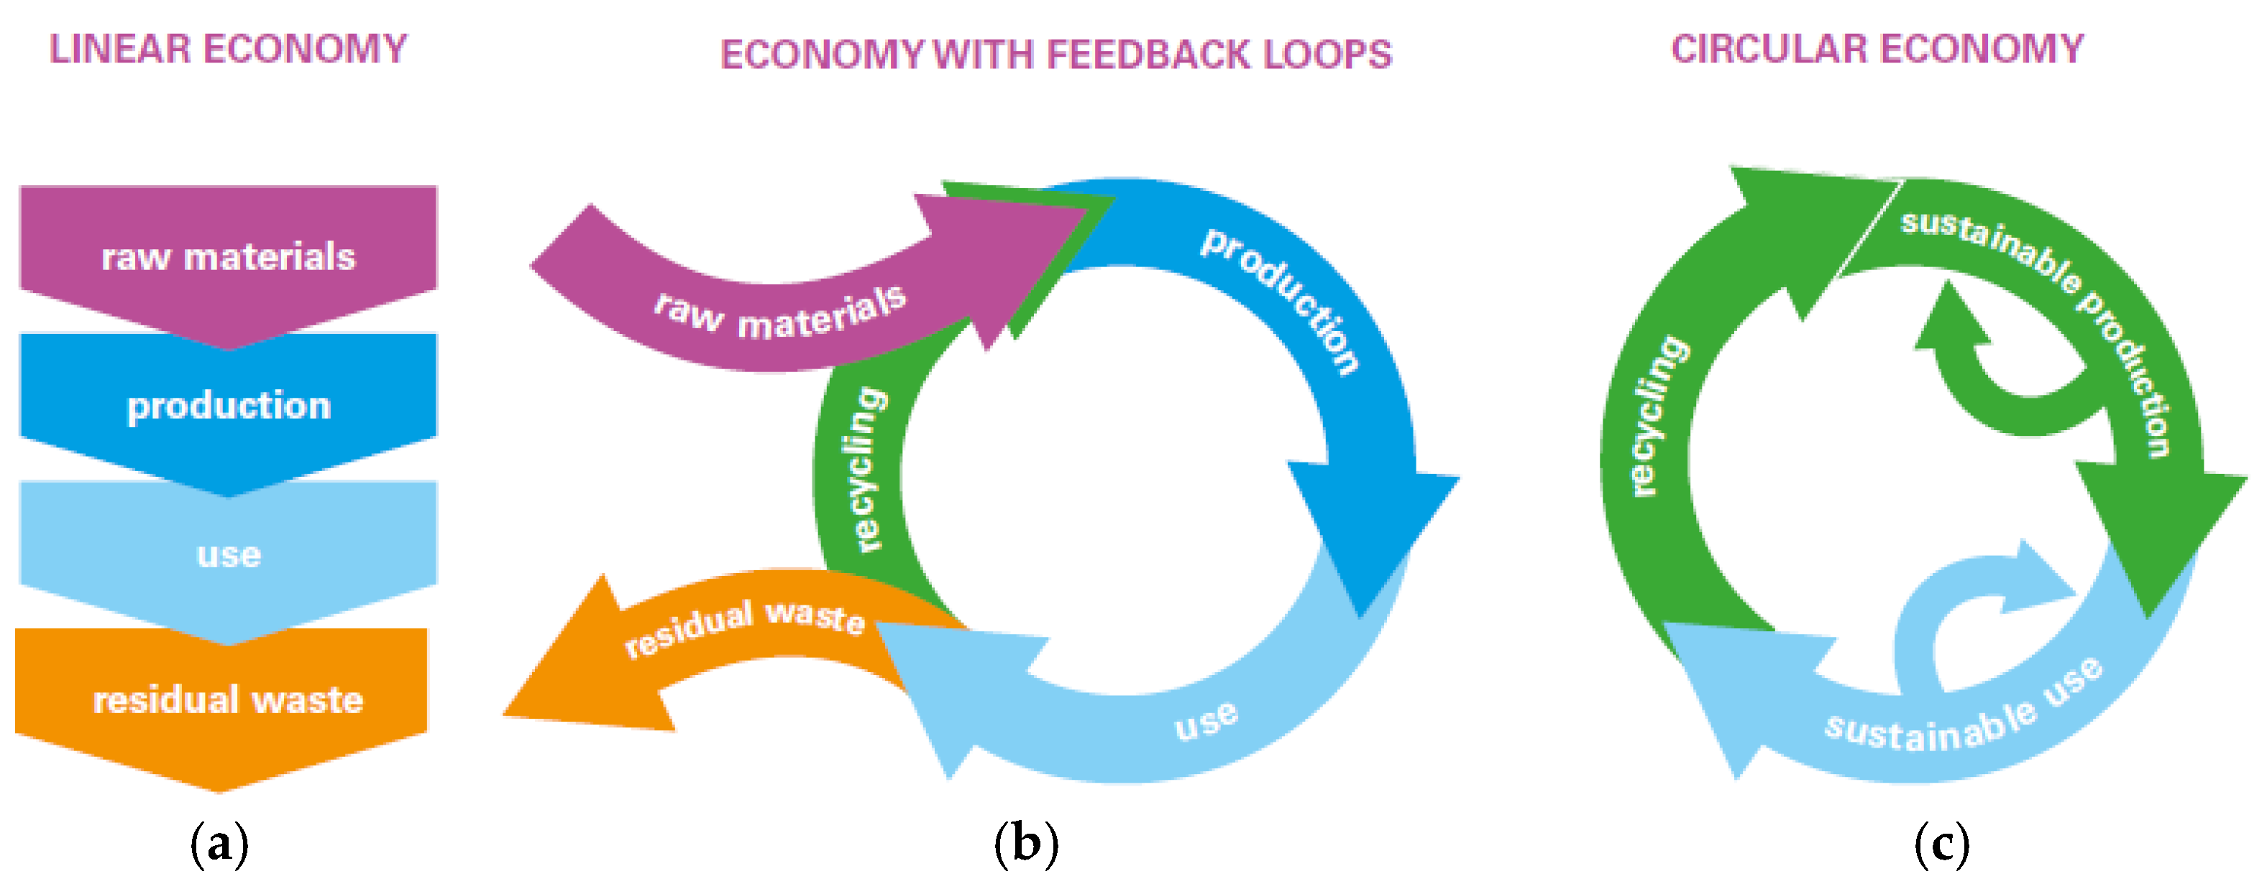
Van Buren, N.; Demmers, M.; Van der Heijden, R.; Witlox, F. Towards a Circular Economy: The Role of Dutch Logistics Industries and Governments. Sustainability 2016, 8, 647. https://doi.org/10.3390/su8070647

Slide 6
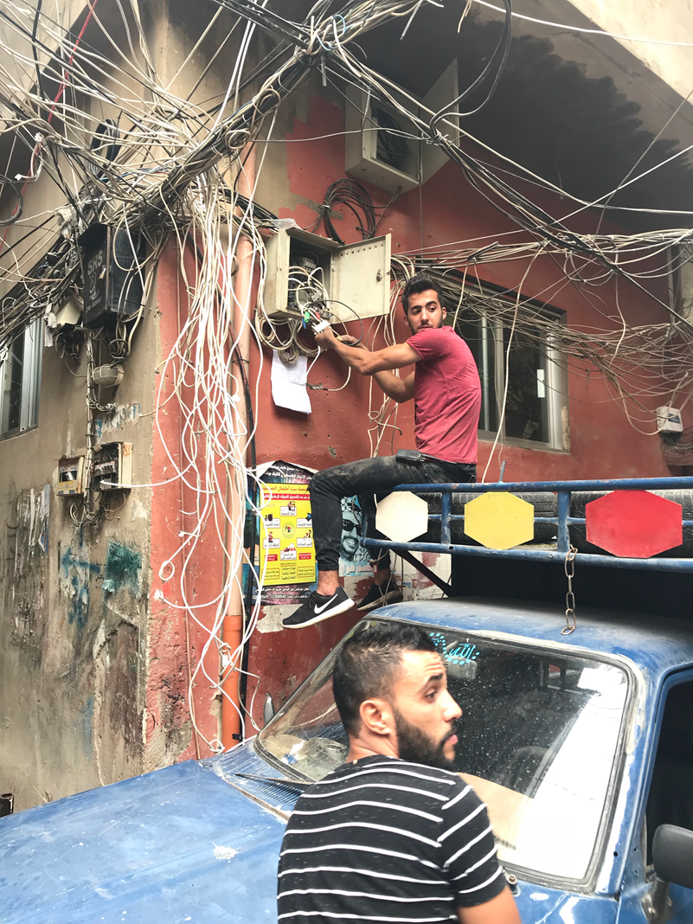
Let’s take a look at the interconnections between the SDGs
Photo: Rauli Virtanen. Beirut, Libanon. 2018.
Notes:
https://www.cbd.int/article/cop15-final-text-kunming-montreal-gbf-221222

Slide 7
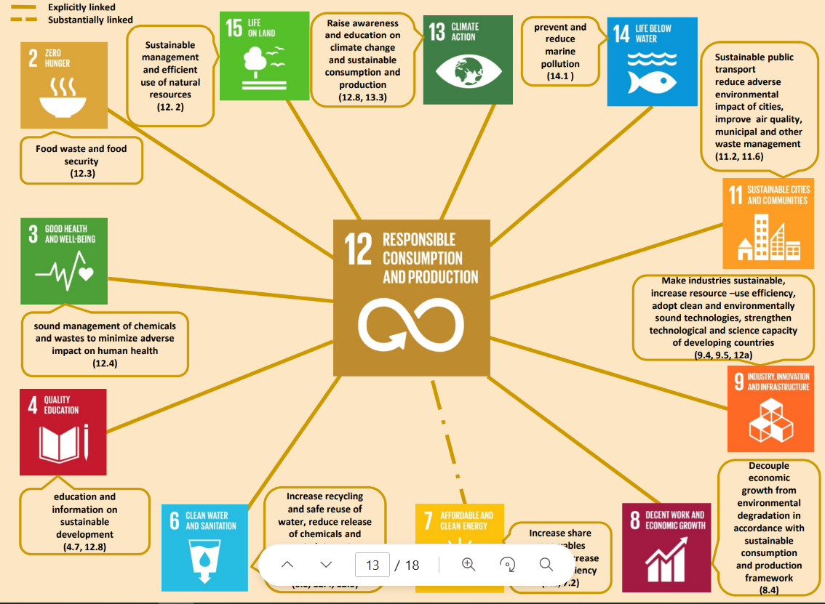
Source: https://www.un.org/ecosoc/sites/www.un.org.ecosoc/files/files/en/2016doc/interlinkages-sdgs.pdf

Slide 8
Technology, science and capacity building are major pillars of the Means of Implementation of the 2030 Agenda
Research, development, deployment, and widespread diffusion of environmentally sound technologies in the context of a Green Economy
Innovation
Business opportunities and development
Trade of environmental goods and services
Finance and investment and
Institutional capabilities.

Slide 9
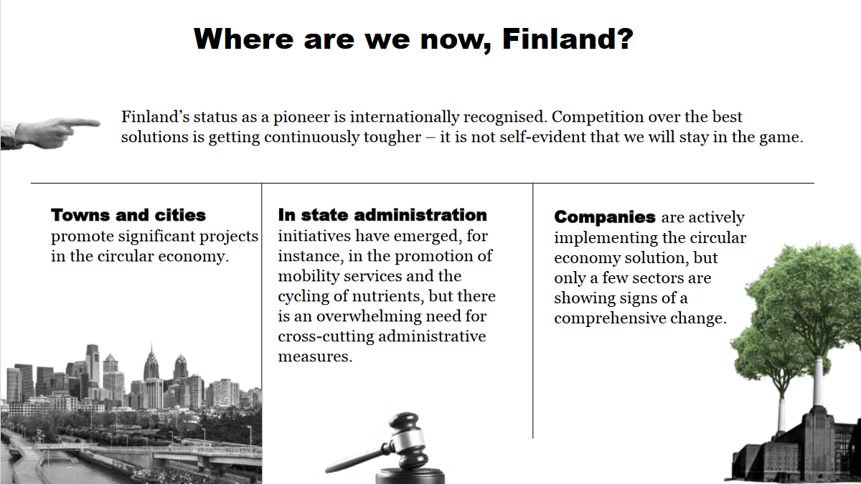
Sitra, 2020. https://www.sitra.fi/en/projects/critical-move-finnish-road-map-circular-economy-2-0/

Slide 10
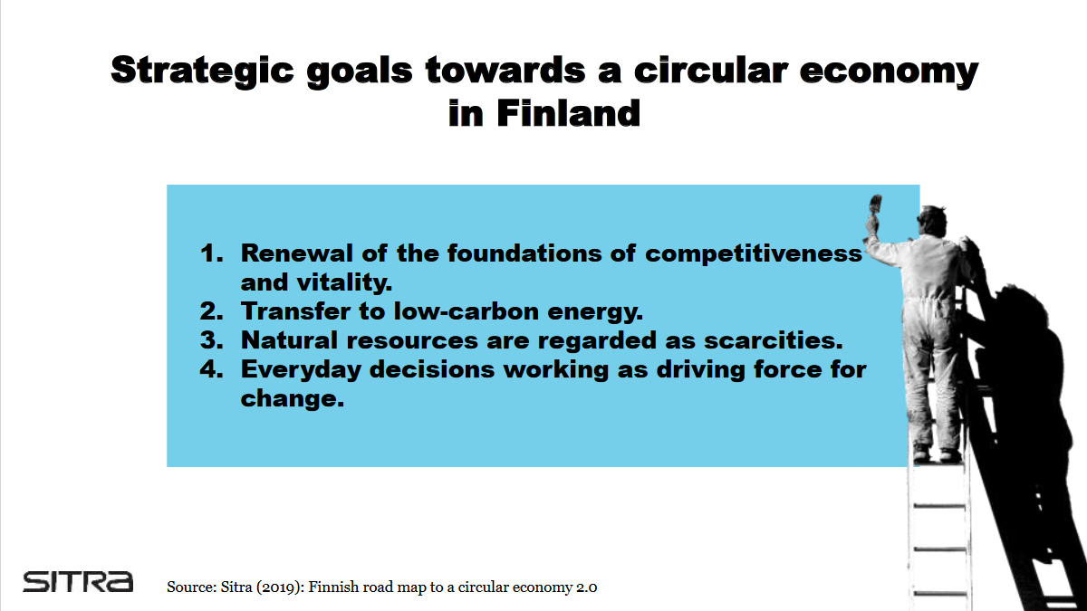

Slide 11
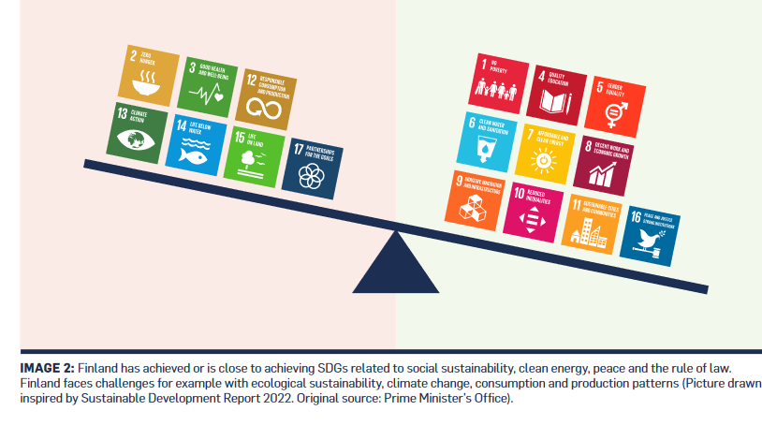
Global Compact Finland, 2023. https://www.globalcompact.fi/page/78?displayformdetails=true&fid=974

Slide 12
Improving circular economy in consumer business
Consumer voucher for repair services
Repair and rent service providers and second hand sellers will get a reduction in VAT
Removal of VAT from donated goods
Extension of home service tax reduction to include reparation services
Removal of waste taxes from circular economy actors
https://kiertotaloussuomi.fi/wp-content/uploads/2023/02/Kiertotalous-%E2%80%93-kuluttajakaupassa-policy-brief-1.pdf

Slide 13
Circular economy in cities: case Tampere
The City of Tampere decided to carry out the renovation of one of its main streets, Yliopistonkatu, using new public circular economy criteria as part of the Design&Build operating model.
The criteria were developed by the city of Tampere, together with the KIEPPI Project, experts from the university, research programmes, the UUMA4 programme and companies. The city pioneered this approach, as it is the first time in Finland that this type of circular economy public procurement criteria are applied.
As part of the procurement development, the chosen contractor had to write an environmental plan, to ensure that environmental criteria were really taken into account.
Examples of criteria used in the procurement process are:
recovered materials used % in the project
environmental plan of the tendering company
transportations trips (km) for building materials (no longer than 20km).
the local company will reutilize at least 70% of the materials generated at the place of origin and of the surpluses generated in the contract outside the contract, using the remaining of the recycled materials outside the contract to up to 50%.
A CO2 calculation about the renovation will be carried out during and after the project.

Slide 14
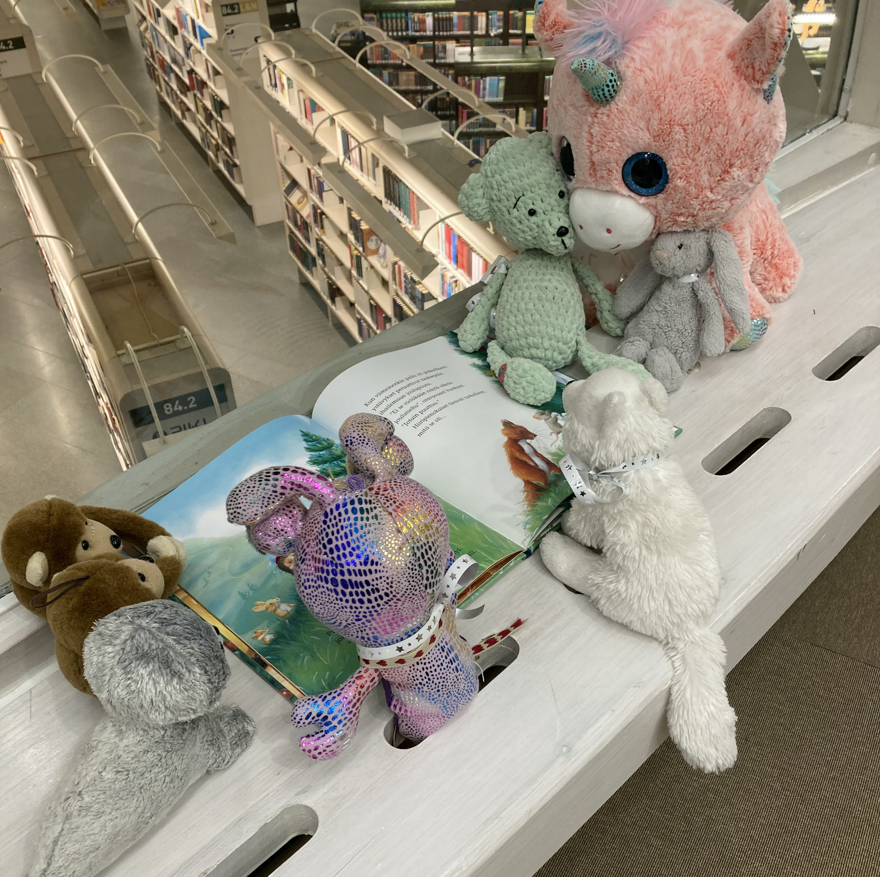
Shift towards non-material economy
The role of culture is important in visioning sustainable futures and in providing experiences that have low ecological impacts
Photo: Paula Rönni. Metso library, Tampere.

Slide 15
Thank you!

