Slide 1
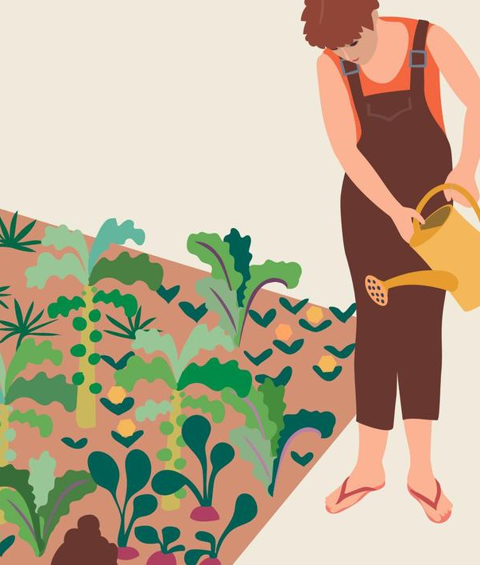
How to empower social transformations?Some thoughts from the field
Dr. Kaidi Tamm ǀ SEI Tallinn ǀ 26.05.2024 Civil society ideas for sustainable green Europe
Notes:
Intro -

Slide 2
Sustainable and green?
Dr. Kaidi Tamm ǀ 26.05.2023 Civil society ideas for sustainable green Europe

Slide 3
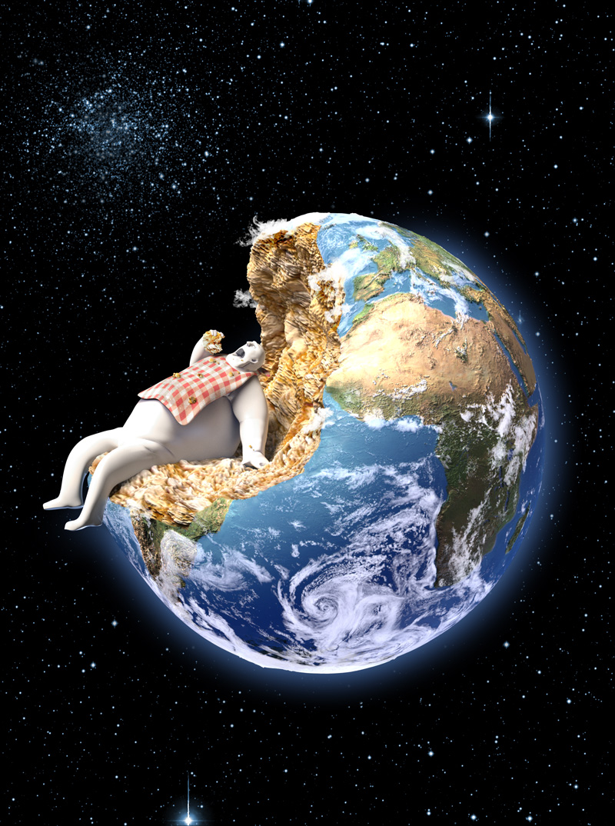
Anthropocene?
Anthropocene is a new geo-chronological era, in which humans have become one of the most important factors influencing biological, geological & atmospheric processes on Earth.
- Paul Crutzen, Geology of mankind, Nature 415, 23 (2002).
Dr. Kaidi Tamm ǀ 26.05.2023 Civil society ideas for sustainable green Europe

Slide 4
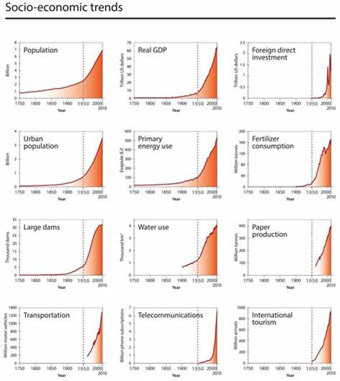
The Great Acceleration
Stage 1: from 1750-1950s Start of the industrial revolution – increasing use of fossil fuels leading to major lifestyle changes and environmental degradation.
Stage 2: 1950s to today The era of the Great Acceleration – a massive simultaneous surge of growth across fields of human activity affecting global geology and ecosystems dramatically.
Dr. Kaidi Tamm ǀ 26.05.2023 Civil society ideas for sustainable green Europe

Slide 5
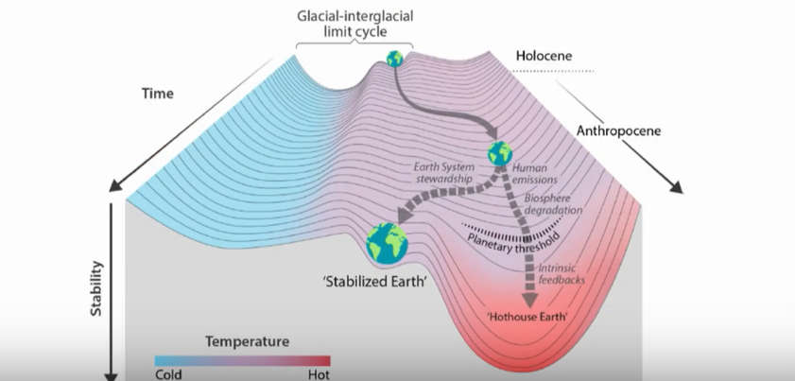
Potential Earth System trajectories in the Anthropocene

Slide 6
„The major problems in the world are the result of the difference between how nature works and the way people think“ - Gregory Bateson, Ecology of the Mind (1972)
Dr. Kaidi Tamm ǀ EU4Transition summer school

Slide 7
Problems (a selection)
Lack of capacity for comprehending and tackling the challenges facing us
Focus on distinct sectoral transitions instead of systematic transformation
Sidelining the cultural aspects of sustainability in favor of changing resource flows and re-organising the processes.
Dr. Kaidi Tamm ǀ 26.05.2023 Civil society ideas for sustainable green Europe

Slide 8
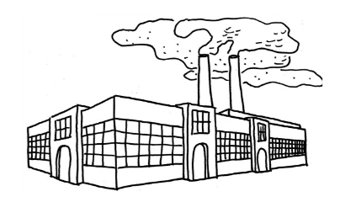
Efficiency strategy
Focuses on improved production.
Producing the same but with lower resource consumption or CO2 emissions.
E.g. through technological innovation and decoupling economic growth from resource use.
This way, we can continue on (green) economic growth path.
Dr. Kaidi Tamm ǀ EU4Transition summer school

Slide 9
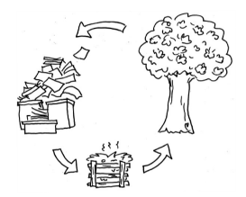
Consistency strategy
Focuses on using a different production model.
Environmetally friendly technology for minimising environmental damage and waste.
Production and consumption are seen as a cycle –> circular economy
Dr. Kaidi Tamm ǀ EU4Transition summer school

Slide 10
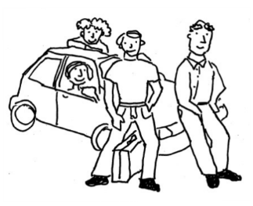
Sufficiency strategy
Focuses on consuming, using & needing less. Therefore also producing less.
Reconsidering what is needed for good life.
Sharing economy, post growth economy
Not just “doing without”, but feeling liberated and content about doing the right thing – ecovillagers are exemplary pioneers here ☺
Dr. Kaidi Tamm ǀ 26.05.2023 Civil society ideas for sustainable green Europe

Slide 11
Combination needed
Efficiency and consistency alone are not enough, we also need to rethink our needs to reduce consumption – we need the power to transcend the ruling paradigms, as Donella Meadows put it.
So, in addition to efficiency and consistency (circularity), we also need a sufficiency revolution!
Dr. Kaidi Tamm ǀ 26.05.2023 Civil society ideas for sustainable green Europe

Slide 12
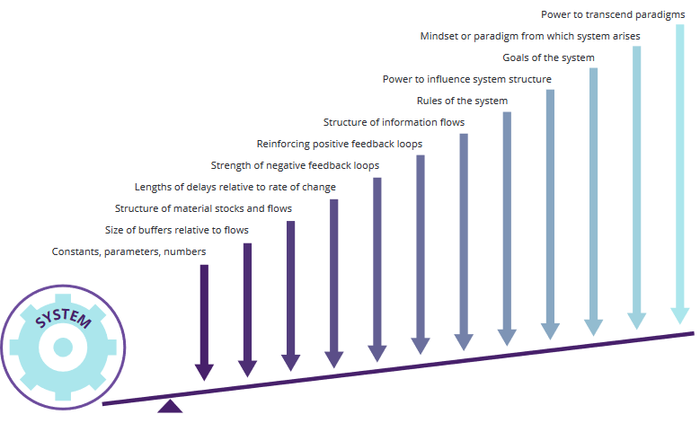
12 leverage points for systems change, based on Meadows 1999
Dr. Kaidi Tamm ǀ 26.05.2023 Civil society ideas for sustainable green Europe

Slide 13
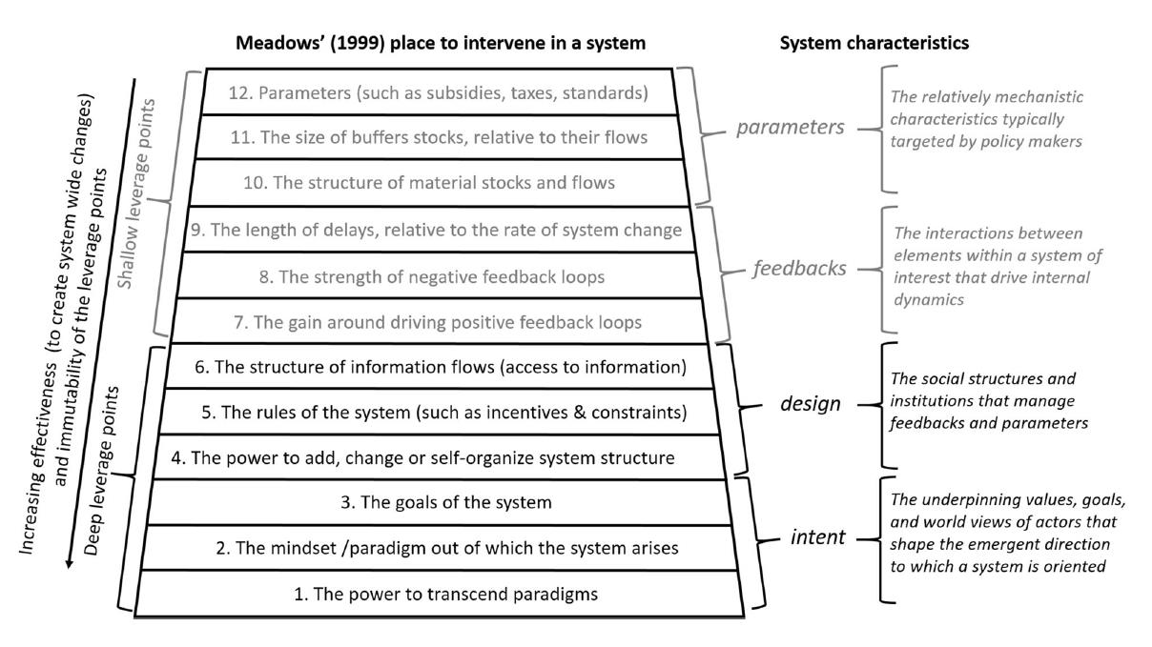
12 leverage points for systems change, based on Meadows 1999
Dr. Kaidi Tamm ǀ KIT Spring Days of Sustainability Leadership for sustainability workshops ǀ March 2022

Slide 14
12 leverage points for systems change
Donella Meadows suggested 12 leverage points for system changes, which correspond to:
Changes in the practical sphere, represented by constants, parameters and numbers and the size of buffers relative to flows, are important, yet they are considered to have little leverage.
Changes in the political sphere have increasingly greater leverage; these are represented by the structure of material stocks and flows, the length of delays relative to the rate of change, the strength of negative feedback loops, the reinforcement of positive feedback loops, the structure of information flows, the rules of the system, and the power to influence system structure.
Changes associated with the personal sphere, which include the goals of the system and the mindset or paradigm from which the system arises, are considered by Meadows to have the greatest leverage points for systems change, exceeded only by the power to transcend paradigms.
Source: Meadows, D. H., 1999, Leverage points: places to intervene in a system, The Sustainability Institute.
Dr. Kaidi Tamm ǀ EU4Transition summer school

Slide 15
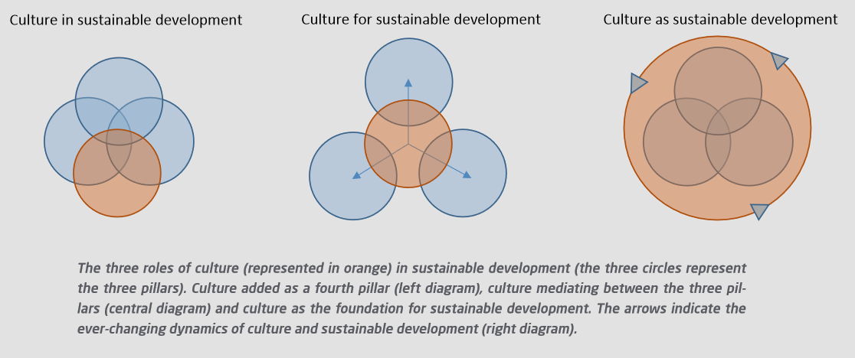
Including culture into the SD equation
Dr. Kaidi Tamm ǀ 26.05.2023 Civil society ideas for sustainable green Europe

Slide 16
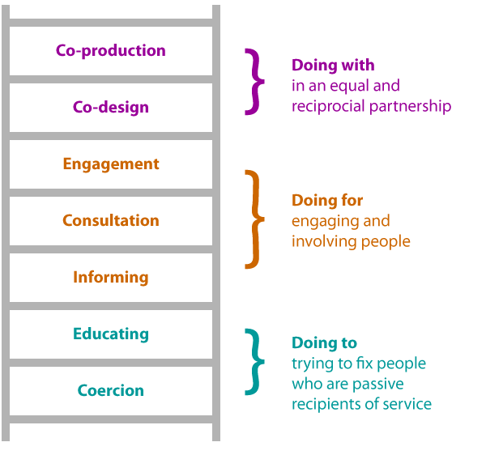
Societal transformations need co-creation
Dr. Kaidi Tamm ǀ 26.05.2023 Civil society ideas for sustainable green Europe

Slide 17
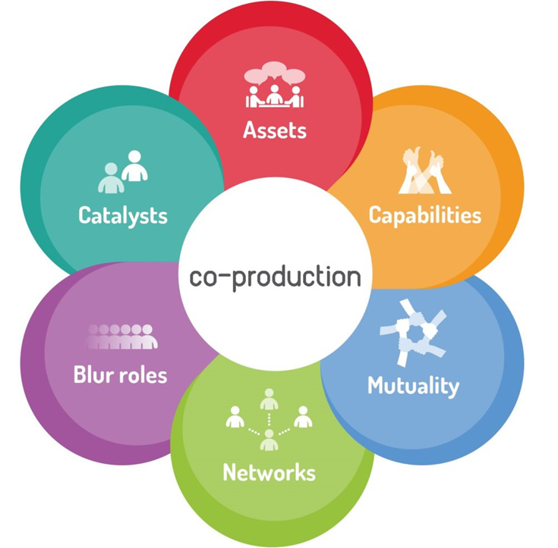
Co-production principles
Recognising people as assets: equal partners in the design and delivery of services;
Building on people’s existing capabilities: co-produced services start with people’s capabilities & look for opportunities to develop them;
Mutuality and reciprocity: co-production is about a mutual and reciprocal partnership;
Peer support networks: peer and personal networks alongside professionals;
Blurring roles: blurring the distinction between professionals, users, family members, community;
Professionals as catalysts of change: enabling professionals to become facilitators of change.
Dr. Kaidi Tamm ǀ 26.05.2023 Civil society ideas for sustainable green Europe

Slide 18
Capacity building: leadership for sustainability
Systems thinking
Transformative learning
Transdisciplinarity
Service learning
Experimental approach
Co-creating the ethics for anthropocene
Taking co-creation/co-production seriously
Building up not only knolwegde, but also inner literacy and skills for remaining resilient in the face of ongoing uncertainty and frustration.
It takes inner change to create the outer change:
Each needs to find suitable methods and tools for personal resilience development
Dr. Kaidi Tamm ǀ 08.07.2022 EU4Transition summer school

Slide 19
Thank you!
Kaidi Tamm ǀ kaidi.tamm@sei.org

