Slide 1
Civil Society Ideas for a Sustainable Green Future of Europe
Kaupo Heinma, Deputy Secretary General
Ministry of the Climate of Estonia

Slide 3

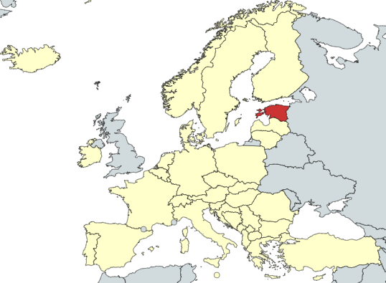
Estonia – facts and figures

Slide 4
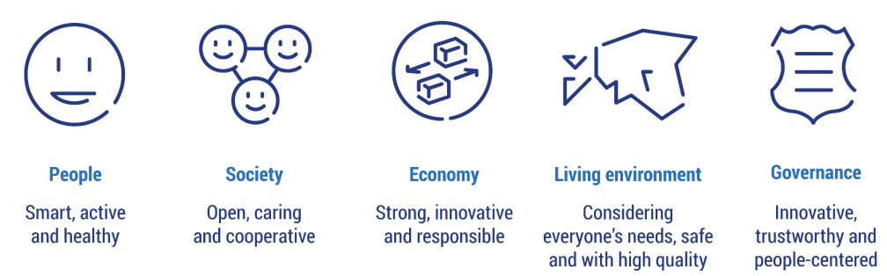
Estonia 2035 – National Development Strategy
By 2050, Estonia will be a competitive, climate-neutral country with a knowledge-based society and economy and a high-quality and species-rich living environment, willing and able to reduce the adverse effects of climate change and make the best use of its positive aspects.
Read more: https://valitsus.ee/strateegia-eesti-2035-arengukavad-ja-planeering/strateegia
Notes:
Strateegia annab ühtse suuna erinevate valdkondade poliitikakujundajatele ja otsustajatele ning eurorahade kasutamisele. Strateegia koostamist vedasid kõikide huviliste osalusel riigikantselei ja rahandusministeerium. Strateegia elluviimist koordineerib riigikantselei.

Slide 5
Environmental Development Plan (KEVAD) until 2030
KEVAD replaces the previously valid "Estonian Environmental Strategy until 2030"
Sets environmental targets for Estonia until 2030
Organizes the strategic planning of the field across sectors
Climate policy is one of the three cross-cutting themes next to biodiversity and the circular economy
Sets new and more ambitious GHG reduction target for 2030
Will include goals and targets for adaptation

Slide 6



Climate change
In 2021, the total emissions of GHGs were 15 497.75 kt (15.6 m tonnes). Total emissions have decreased 68,5% (without LULUCF) and 57.63% (with LULUCF) (compared to 1990 levels)
The Energy sector is the most significant source of greenhouse gas emissions in Estonia - energy industry and production formed 52% share of the total emissions in 2021.
Since the base year 1990, total GHG emissions from Energy sector in Estonia have decreased by 71.2%. The key driver for the fall in emissions is the transition from a planned economy to a market economy, and impacts of EU ETS system.

Slide 7
The context: Greenhouse gas emissions 1990 – 2020
2020 vs 1990:
- 65% incl. LULUCF
- 71% not incl. LULUCF
EE2035:
- net 8 mln t
EE2035:
- climate neutrality
Notes:
GHG emissions in 2020 12,85 million tons – smaller than expected due to COVID
GHG emissions have been reduced by 65% compared to 1990 (71% if LULUCF is not included)
The largest reductions have occurred in the energy sector
Main energy sector changes due to the decreased volumes in the energy sector in the early 1990s and energy transition together with high C prices over the last few years
With the reduced emissions in the energy sector, the proportion of the energy sector emissions has also decreased, being 91% in 1990 and 59% in 2020
Projections are also depicted here together with Estonia 2035 targets

Slide 8

In Estonia 2035, the following targets have been set for 2035
z
Net GHG emissions reduction – 8 mln t CO2 eq
Circular material use rate – 30%
Sustainable development in Estonia – top 10
Resource productivity – 0,9 €/kg

Slide 9
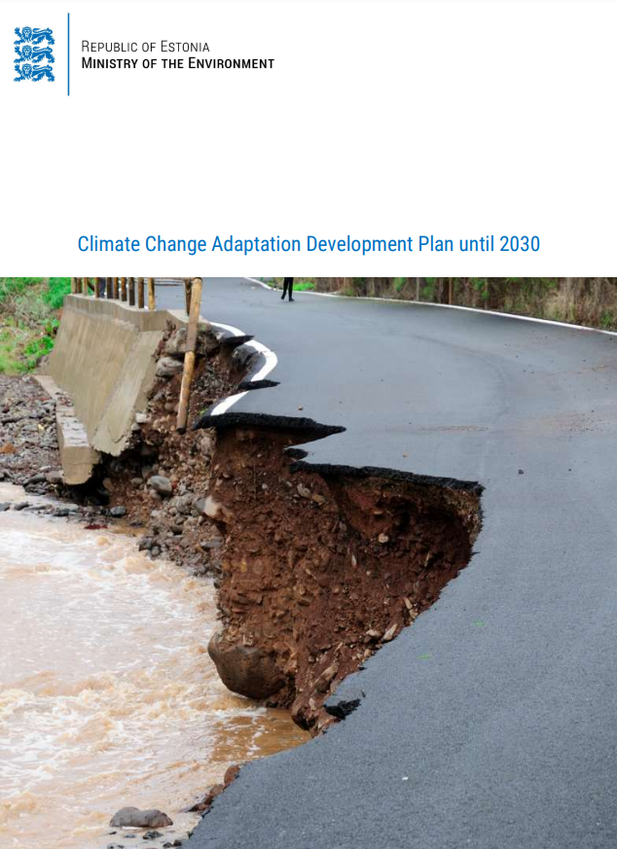
National Adaptation Strategy until 2030
Aims to Enhance Estonia's preparedness and capability to adapt to the impacts of climate change locally, regionally and nationally.
8 PRIORITY SECTORS:
Spatial planning and land use
Human health and rescue preparedness
Natural environment
Bioeconomy
Buildings and infrastructure
Energetics and energy supply systems
Economy
Society, awareness and co-operation
Read more: https://envir.ee/kliimamuutustega-kohanemise-arengukava
Climate Change Adaptation Development Plan until 2030

Slide 10
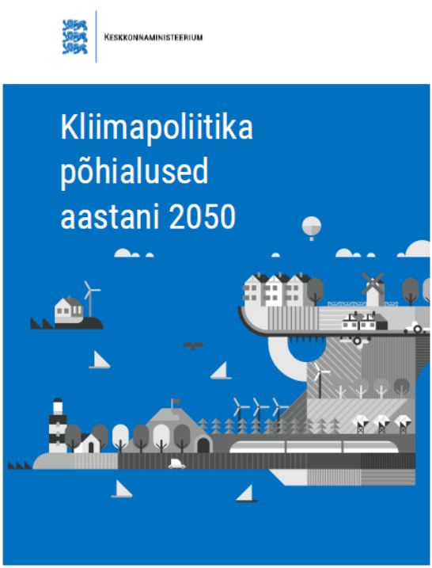

Low Carbon Strategy until 2050
General climate policy principles
GHG reduction targets
Cross-border cooperation
Currently in parliament to update GHG targets
Read more: https://envir.ee/kliimapoliitika-pohialused-aastani-2050
General Principles of Climate Policy until 2050
Notes:
Kliimapoliitika põhialuste koostamine algatati Vabariigi Valitsuse 2014. aasta 7. augusti kabinetinõupidamise ettepanekul. 2016. aasta detsembris kiitis Vabariigi Valitsus kliimapoliitika põhialuste dokumendi heaks ja saatis selle arutamiseks Riigikogu komisjonidesse. 5. aprillil 2017. aastal kiideti „Kliimapoliitika põhialused aastani 2050“ Riigikogus heaks.

Slide 11
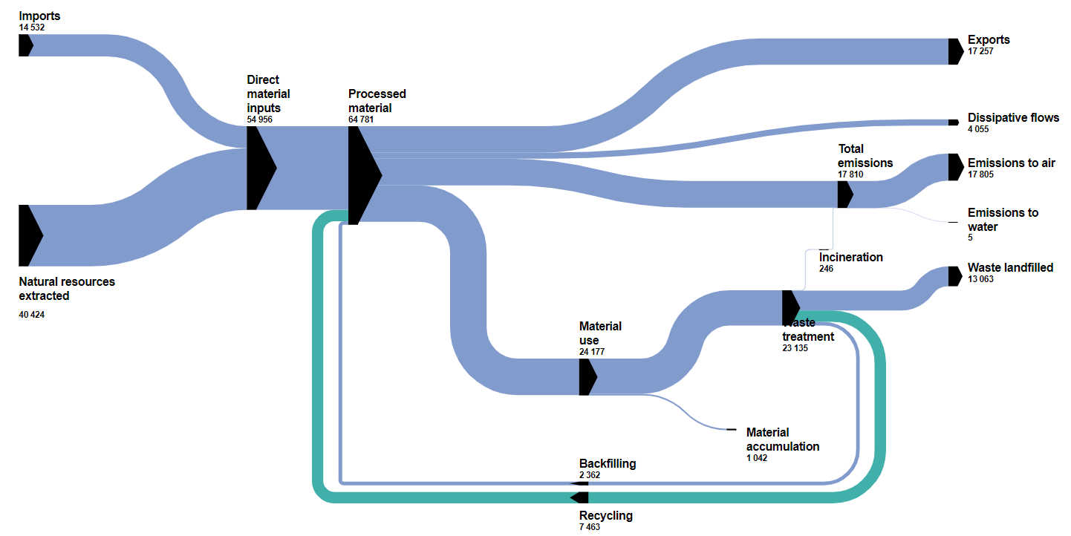
Material flow diagramm for Estonia 2020, 1000 tonnes

Slide 12

Oil shale mining
As the coalision treaty is rather new, we are mapping out ways how to set and achieve the goals in the aspect of climate and aswell energy demand and therefore there is a need to analyse oil shale mining permissions and regulative issues concerned with climate scopes and phasing out fossil fuels.

Slide 13
The White Paper for a Circular Economy
The vision:
Estonia has a functioning circular system of production and consumption, and we are a smart country leading the transition to circular economy.
6 development priorities have been set:
Resources are used responsibly and based on demand, resource use is well-considered and waste production is minimized
The business models of Estonian companies are forward-looking and circular
The necessary know-how and expertise for implementing circular economy is ensured and the cooperation between stakeholders and sectors is well-functioning
Functional digital solutions have been created to support the circular economy and high-quality data for monitoring the situation has been ensured
The circular economy is well coordinated and there is a supportive legal and economic environment
Environmentally conscious thinking and environmentally friendly behaviour are mainstreamed in the society
More information can be found: https://ringmajandus.envir.ee/index.php/en/strategy

Slide 14
Sustainable development and sustainable finance

Slide 15
Have you been asked about your level of sustainability?
22
%
I am
not
aware
of
it
50
%
Yes
28
%
No

Slide 16
Are you aware, how the sustainability reporting will affect you?
17
%
Yes
13
%
No
65
%
Only
partly
Allikas: Eesti kestliku rahastuse TSI projekt, EBRD, KPMG, Eversheds Sutherlands

Slide 17
Sustainability and co-operation with civil society
The climate and youth council to advise the Ministry of Climate
Sustainability requirements for sustainable finance reporting – one must work together with the local stakeholders and civil socidety
The Climate Law
Principles for a Value-based Circular Economy

Slide 18

Main strategies
Development of the New Strategy for the Environment
Development of the Climate Law for Estonia
Strategy for Sustainable Finance for Estonia
Integration of Energy, Transport and Climate and Environment to a new Climate Ministry by July 2023
Focus on Green and Just Transition – the new Government Working Programme
A personal Representative for Ida-Virumaa
Full reorganisation for the Green Transition in the Structures
Digitalisation in sustainability and environment pathways

Slide 19
Environmental management tools for awareness, information and co-operation
Eco-labels – consumer information and awareness
Public sustainable and green procurement – public sector as a role model and value-based decisions
Voluntary agreements with sectors and civil society – information sharing and lõng-term goals
Environmental charges – a financial framework for knowledgeable decisions

Slide 20
Thank you!
z

